Slide 1

CSCI 466: Networks
More on IP Addressing, NAT, Subnets + Routing
Reese Pearsall Fall 2024
https://www.cs.montana.edu/pearsall/classes/fall2024/466/main.html
*All images are stolen from the internet
1

Slide 2
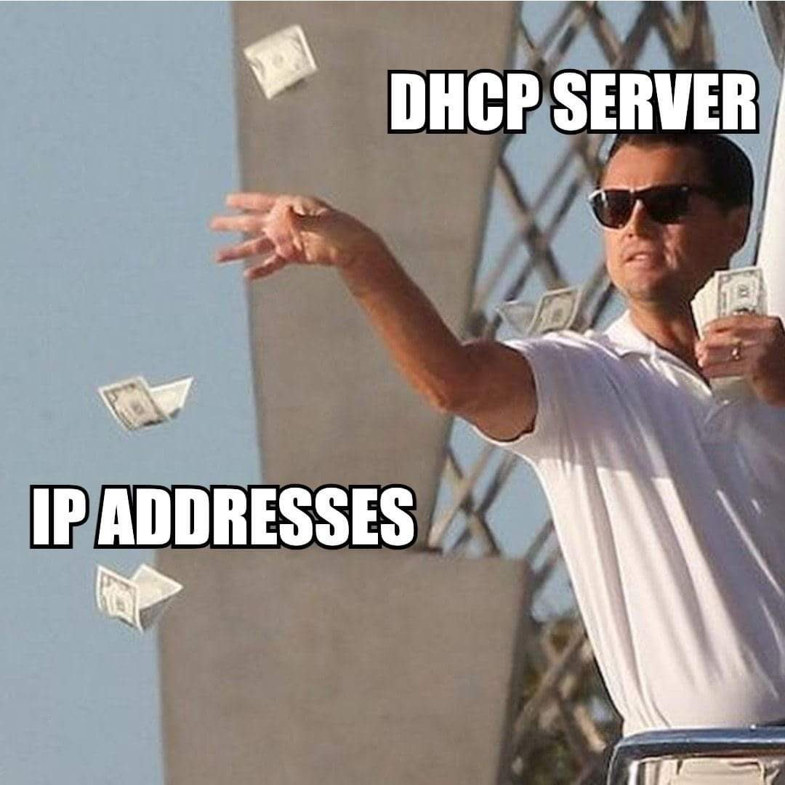
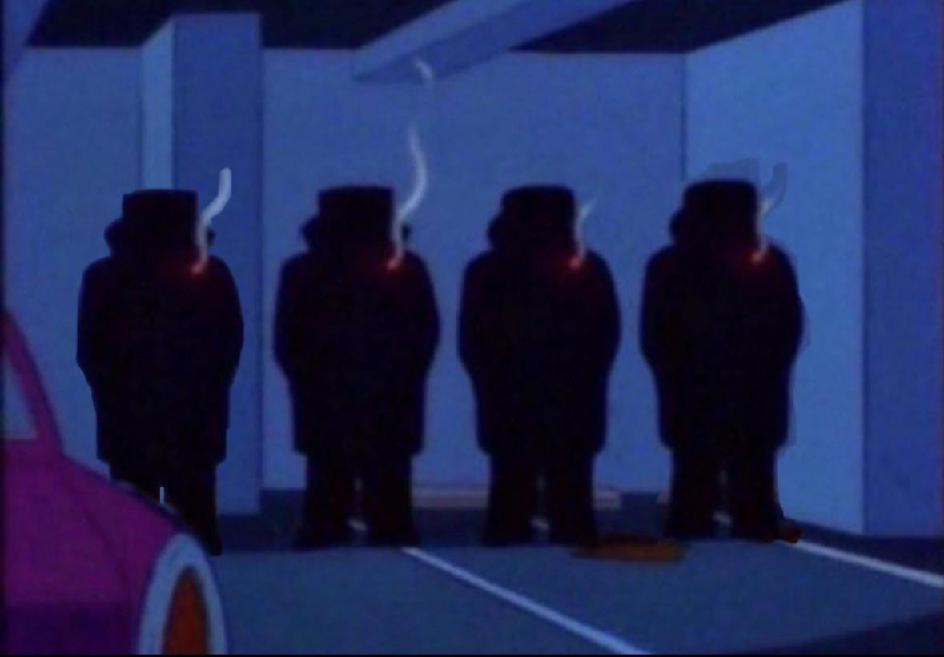
Announcements
PA2 due on Sunday (10/13)
192.168.1.1
192.168.1.3
192.168.1.2
192.168.1.4

Slide 3

MSU Video Game Development club has their first meeting tonight at 5PM in SUB 235

Slide 4


Application Layer
Presentation Layer
*
Application Layer
Session Layer
*
Messages from Network Applications
Transport Layer
Network Layer
Physical Layer
Data Link Layer
Bits being transmitted over a medium
Physical Layer
*In the textbook, they condense it to a 5-layer model,
but 7 layers is what is most used

Slide 5
IP Address: 32 bit (4 byte) dotted decimal number assigned to interfaces on hosts and routers
IP addresses are heavily used in the routing process and ensuring packets get sent to the correct location
193.32.216.9
An IP address has two parts: the network bits and host bits
(area code)
(phone number)

Slide 6
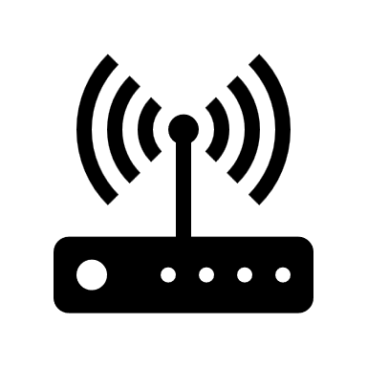

IP Address: 32 bit (4 byte) dotted decimal number assigned to interfaces on hosts and routers
IP addresses are heavily used in the routing process and ensuring packets get sent to the correct location
193.32.216.9
An IP address has two parts: the network bits and host bits
(area code)
(phone number)
(Gateway Router)
193.32.216.9
193.32.216.23
193.32.216.254

Slide 7

IP Address: 32 bit (4 byte) dotted decimal number assigned to interfaces on hosts and routers
IP addresses are heavily used in the routing process and ensuring packets get sent to the correct location
193.32.216.9
An IP address has two parts: the network bits and host bits
(area code)
(phone number)
Subnet
(Gateway Router)
193.32.216.9
193.32.216.23
193.32.216.254

Slide 8
IP Address: 32 bit (4 byte) dotted decimal number assigned to interfaces on hosts and routers
An IP address has two parts: the network bits and host bits
Devices on the same subnet will have the same network bits for their IP address
(Gateway Router)
193.32.216.9
193.32.216.23
193.32.216.254

Slide 9
Devices on the same subnet will have the same network bits for their IP address
Each device has the subnet mask for their network
(Gateway Router)
193.32.216.9
193.32.216.23
193.32.216.254
11.55.44.25

Slide 10
Devices on the same subnet will have the same network bits for their IP address
Each device has the subnet mask for their network
193.32.216.9
The first 24 bits (3 octets) are the network bits
(Gateway Router)
193.32.216.9
193.32.216.23
193.32.216.254
11.55.44.25

Slide 11
Devices on the same subnet will have the same network bits for their IP address
Each device has the subnet mask for their network
193.32.216.9
The first 24 bits (3 octets) are the network bits
193.32.216.0 /24
Subnet Mask
11111111 1111111 1111111 0000000
(Gateway Router)
193.32.216.9
193.32.216.23
193.32.216.254
11.55.44.25

Slide 12
Devices on the same subnet will have the same network bits for their IP address
Each device has the subnet mask for their network
193.32.216.9
The first 24 bits (3 octets) are the network bits
193.32.216.0 /24
Subnet Mask
Network bits
Host bits
11111111 1111111 1111111 0000000
(Gateway Router)
193.32.216.9
193.32.216.23
193.32.216.254
11.55.44.25

Slide 13

Devices on the same subnet will have the same network bits for their IP address
Each device has the subnet mask for their network
DST IP: 193.32.216.254
Source IP: 193.32.216.9
(Gateway Router)
193.32.216.9
193.32.216.23
193.32.216.254
11.55.44.25
A
B
C

Slide 14
Devices on the same subnet will have the same network bits for their IP address
Each device has the subnet mask for their network
First question asked when routing:
Is this packet going to somewhere on my network ?
DST IP: 193.32.216.254
Source IP: 193.32.216.9
(Gateway Router)
193.32.216.9
193.32.216.23
193.32.216.254
11.55.44.25
A
B
C

Slide 15
Devices on the same subnet will have the same network bits for their IP address
Each device has the subnet mask for their network
First question asked when routing:
Is this packet going to somewhere on my network ?
Does the destination IP have the same network bits as me ?
DST IP: 193.32.216.254
Source IP: 193.32.216.9
(Gateway Router)
193.32.216.9
193.32.216.23
193.32.216.254
11.55.44.25
A
B
C

Slide 16
A subnet mask tells a device which bits of an IP address are the host bits and network bits
Devices on the same subnet will have the same network bits for their IP address
Each device has the subnet mask for their network
DST IP: 193.32.216.254
11000001 00100000 11011000 11111110
DST IP: 193.32.216.254
Source IP: 193.32.216.9
11111111 11111111 11111111 00000000
Subnet mask of A
(Gateway Router)
193.32.216.9
193.32.216.23
193.32.216.254
11.55.44.25
A
B
C

Slide 17
A subnet mask tells a device which bits of an IP address are the host bits and network bits
Devices on the same subnet will have the same network bits for their IP address
Each device has the subnet mask for their network
DST IP: 193.32.216.254
11000001 00100000 11011000 11111110
DST IP
Source IP
DST IP: 193.32.216.254
Source IP: 193.32.216.9
11111111 11111111 11111111 00000000
Subnet mask of A
11000001 00100000 11011000 00011001
(Gateway Router)
193.32.216.9
193.32.216.23
193.32.216.254
11.55.44.25
A
B
C

Slide 18
A subnet mask tells a device which bits of an IP address are the host bits and network bits
Devices on the same subnet will have the same network bits for their IP address
Each device has the subnet mask for their network
DST IP: 193.32.216.254
11000001 00100000 11011000 11111110
DST IP
Source IP
DST IP: 193.32.216.254
Source IP: 193.32.216.9
11111111 11111111 11111111 00000000
Subnet mask of A
11000001 00100000 11011000 00011001
They have matching network bits, so this packet needs to be sent within the network!
(Gateway Router)
193.32.216.9
193.32.216.23
193.32.216.254
11.55.44.25
A
B
C

Slide 19
Devices on the same subnet will have the same network bits for their IP address
Each device has the subnet mask for their network
First question asked when routing:
Is this packet going to somewhere on my network ?
DST IP: 11.55.44.25
Source IP: 193.32.216.9
(Gateway Router)
193.32.216.9
193.32.216.23
193.32.216.254
11.55.44.25
A
B
C

Slide 20
Devices on the same subnet will have the same network bits for their IP address
Each device has the subnet mask for their network
00001011 00110111 00101100 00011001
DST IP
Source IP
DST IP: 11.55.44.25
Source IP: 193.32.216.9
11111111 11111111 11111111 00000000
Subnet mask of A
11000001 00100000 11011000 00011001
(Gateway Router)
193.32.216.9
193.32.216.23
193.32.216.254
11.55.44.25
A
B
C

Slide 21
Devices on the same subnet will have the same network bits for their IP address
Each device has the subnet mask for their network
00001011 00110111 00101100 00011001
DST IP
Source IP
DST IP: 11.55.44.25
Source IP: 193.32.216.9
11111111 11111111 11111111 00000000
Subnet mask of A
11000001 00100000 11011000 00011001
(Gateway Router)
193.32.216.9
193.32.216.23
193.32.216.254
11.55.44.25
A
B
C

Slide 22
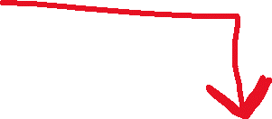
Devices on the same subnet will have the same network bits for their IP address
Each device has the subnet mask for their network
00001011 00110111 00101100 00011001
DST IP
Source IP
DST IP: 11.55.44.25
Source IP: 193.32.216.9
11111111 11111111 11111111 00000000
Subnet mask of A
11000001 00100000 11011000 00011001
They do not have matching network bits, so this packet needs to be sent to the gateway router
(Gateway Router)
193.32.216.9
193.32.216.23
193.32.216.254
11.55.44.25
A
B
C

Slide 23
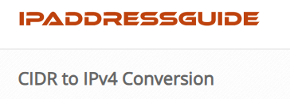
Classful networks:
Class A: /8
Class B: /16
Class C: /24
Now obsolete!
64.201.33.0 /24
(256 usable IPs)
64.201.33.0 - 64.201.33.255
64.201.33.0 /20
(4096 usable IPs)
64.201.32.0 - 64.201.47.255
64.201.33.0 /9
(8,388,608 usable IPs)
64.128.0.0 - 64.255.255.255
The more bits we allocate for host bits, the more IP addresses we can fit on a network!

Slide 24
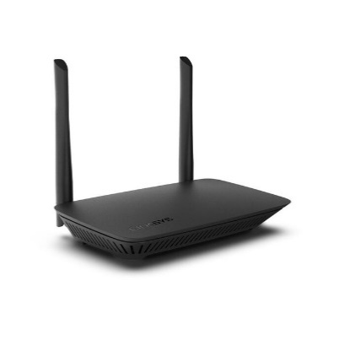

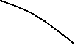
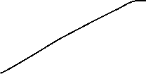
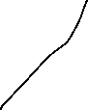




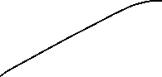


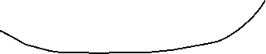
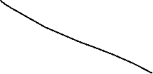
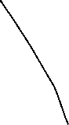
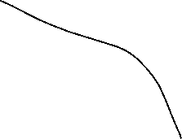

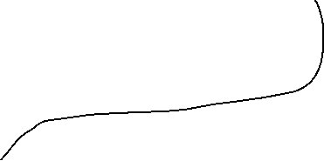
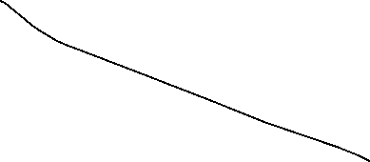


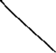
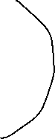
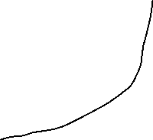
200.23.16.0/20
One Subnet

Slide 25

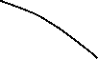
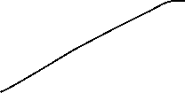





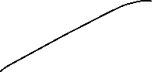


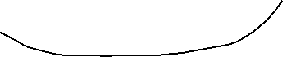
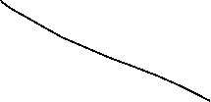
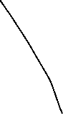
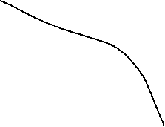


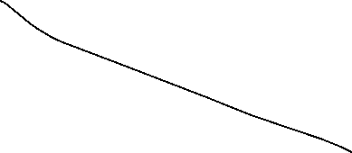


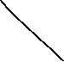
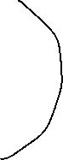
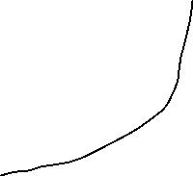
Four Subnets

Slide 26
200.23.16.0/20
11001000 00010111 00010000 00000000
Four Subnets

Slide 27

200.23.16.0/20
11001000 00010111 00010000 00000000
1. 11001000 00010111 00010000 00000000
2. 11001000 00010111 00010100 00000000
3. 11001000 00010111 00011000 00000000
4. 11001000 00010111 00011100 00000000
Network Bits
Subnet Bits
Host Bits
Four Subnets

Slide 28
200.23.16.0/20
11001000 00010111 00010000 00000000
1. 11001000 00010111 00010000 00000000 200.23.16.0/22
2. 11001000 00010111 00010100 00000000 200.23.20.0/22
3. 11001000 00010111 00011000 00000000 200.23.24.0/22
4. 11001000 00010111 00011100 00000000 200.23.28.0/22
Four Subnets

Slide 29
200.23.16.0/22
200.23.20.0/22
200.23.24.0/22
200.23.28.0/22
Four Subnets

Slide 30
Subnetting for IPv6 networks exist, and function very similar
No subnet mask (called “prefix length” in IPv6)

Slide 31

When a host joins a network, they are assigned a private IP address from DHCP
The
Internet
11.22.33.44

Slide 32
When a host joins a network, they are assigned a private IP address from DHCP
192.168.1.10
The
Internet
192.168.1.20
203.0.113.5
The gateway router will have a public IP address*
11.22.33.44
192.168.1.30

Slide 33
When a host joins a network, they are assigned a private IP address from DHCP
192.168.1.10
The
Internet
192.168.1.20
203.0.113.5
The gateway router will have a public IP address*
11.22.33.44
Does spectrum have 56,000 public IP addresses available for all their Bozeman clients ?
192.168.1.30

Slide 34

When a host joins a network, they are assigned a private IP address from DHCP
192.168.1.10
The
Internet
192.168.1.20
203.0.113.5
The gateway router will have a public IP address*
11.22.33.44
Large ISPs will have their own NAT that translates private residential networks to public IPv4 addresses
192.168.1.30

Slide 35
To: 11.22.33.44
From: 192.168.1.10
192.168.1.10
The
Internet
192.168.1.20
203.0.113.5
The gateway router will have a public IP address*
11.22.33.44
192.168.1.30

Slide 36
The router uses Network Address Translation (NAT) and converts private IP addresses to public (and vice versa)
192.168.1.10
To: 11.22.33.44
From: 192.168.1.10
The
Internet
192.168.1.20
203.0.113.5
The gateway router will have a public IP address*
11.22.33.44
192.168.1.30

Slide 37
The router uses Network Address Translation (NAT) and converts private IP addresses to public (and vice versa)
192.168.1.10
To: 11.22.33.44
From: 203.0.113.5
The
Internet
192.168.1.20
203.0.113.5
The gateway router will have a public IP address*
11.22.33.44
192.168.1.30

Slide 38
The router uses Network Address Translation (NAT) and converts private IP addresses to public (and vice versa)
192.168.1.10
If we ever get something back from 11.22.33.44, we know it needs to go to 192.168.1.10
To: 11.22.33.44
From: 203.0.113.5
The
Internet
192.168.1.20
203.0.113.5
The gateway router will have a public IP address*
11.22.33.44
192.168.1.30

Slide 39
The router uses Network Address Translation (NAT) and converts private IP addresses to public (and vice versa)
192.168.1.10
To: 203.0.113.5
From: 11.22.33.44
The
Internet
192.168.1.20
203.0.113.5
The gateway router will have a public IP address*
11.22.33.44
192.168.1.30

Slide 40
The router uses Network Address Translation (NAT) and converts private IP addresses to public (and vice versa)
192.168.1.10
To: 192.168.1.10
From: 11.22.33.44
The
Internet
192.168.1.20
203.0.113.5
The gateway router will have a public IP address*
11.22.33.44
192.168.1.30

Slide 41

To: 192.168.1.10
From: 11.22.33.44
The router uses Network Address Translation (NAT) and converts private IP addresses to public (and vice versa)
192.168.1.10
The
Internet
192.168.1.20
203.0.113.5
The gateway router will have a public IP address*
11.22.33.44
192.168.1.30

Slide 42
Routers use Network Address Translation (NAT) and converts private IP addresses to public (and vice versa)
Any weird situations that could happen?
192.168.1.10
The
Internet
192.168.1.20
203.0.113.5
The gateway router will have a public IP address*
11.22.33.44
192.168.1.30

Slide 43
Routers use Network Address Translation (NAT) and converts private IP addresses to public (and vice versa)
To: 11.22.33.44 From: 192.168.1.10
192.168.1.10
The
Internet
192.168.1.20
203.0.113.5
The gateway router will have a public IP address*
11.22.33.44
To: 11.22.33.44 From: 192.168.1.30
192.168.1.30

Slide 44
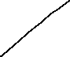


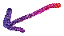

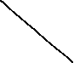
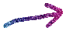
Because private IP addresses are only used internally within a subnet, devices on the internet can have the same private IP address (which is fine!)
192.168.0.1
The Internet
192.168.0.2
12.234.56.78
192.168.0.3
56.131.23.89
Devices on the same subnet should not have same private IP addresses
192.168.0.6
192.168.0.1
192.168.0.5

Slide 45
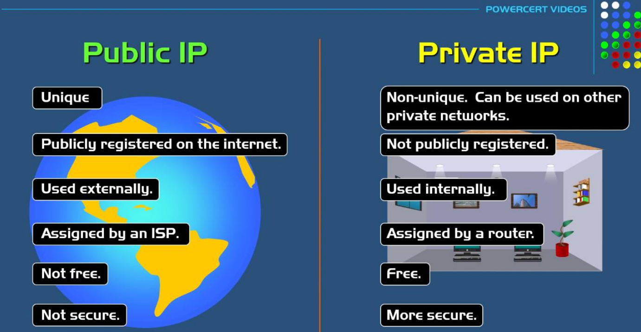

Slide 46
How to see your public/private IP address

Slide 47
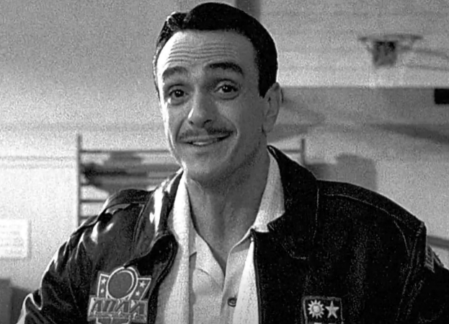
The three Rs of NAT
NAT Router MUST
Outgoing Datagram: Replace
(Source IP Address, Port #) → (NAT IP address, new port #)
Remember
In some kind of NAT table data structure
Incoming Datagram: Replace
(NAT IP Address, new Port #) → (Source IP Address, Port #)
(private) (public)
“If you remember the three Rs of NAT, no amount of IP addresses on earth can fool you”
Patches O’Houlihan
(probably)
(public) (private)

Slide 48
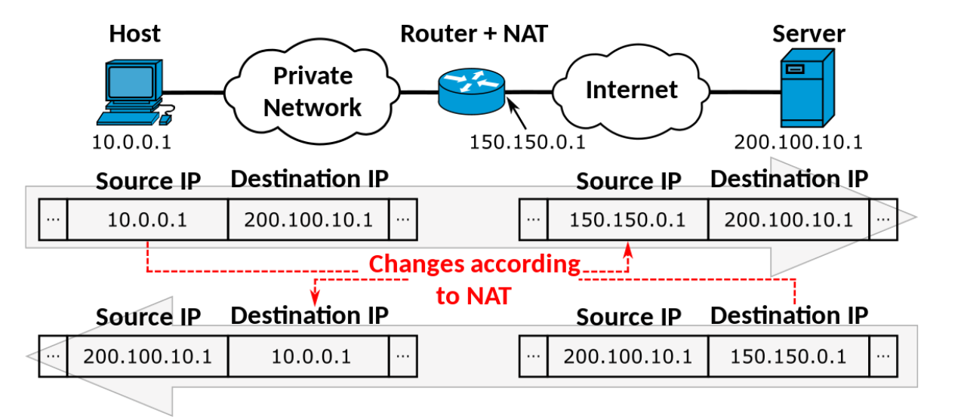

Slide 49
The following IP ranges are reserved for private IP addressing
192.168.X.X
10.X.X.X
172.16.X.X
(class c networks)
(class a networks)
(class b networks)
This means that you will never see a public IP address that begins with these prefixes

Slide 50
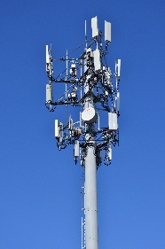
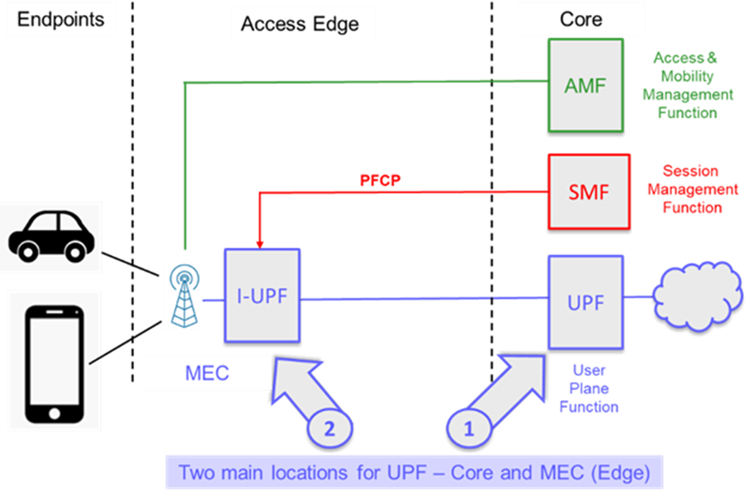

Smartphones get IP addresses just like normal hosts
Wi-Fi
Cellular Network
192.168.1.2
192.168.1.3
192.168.1.4
The user plane function/packet gateway handles things like NAT/DHCP for cellular networks

Slide 51
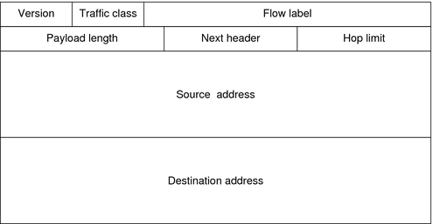
Packets traversing through the network layer are referred to as a datagram. Each packet gets an IPv4/IPv6 header
Transport Layer Header
IP Header
Message
Transport
Layer Header
TCP header = 20 bytes IP header = 20 bytes
Message
IPv6 = 128 bits
IPv6 Header
(128 bits)
(128 bits)

Slide 52
Issue: some routers use IPv4, some use IPv6, some use both. How do we get all networking equipment to coexist with each other?
IPv6
IPv4
IPv6
Solution:

Slide 53
Issue: some routers use IPv4, some use IPv6, some use both. How do we get all networking equipment to coexist with each other?
IPv6
IPv4
IPv6
Solution: Tunneling

Slide 54
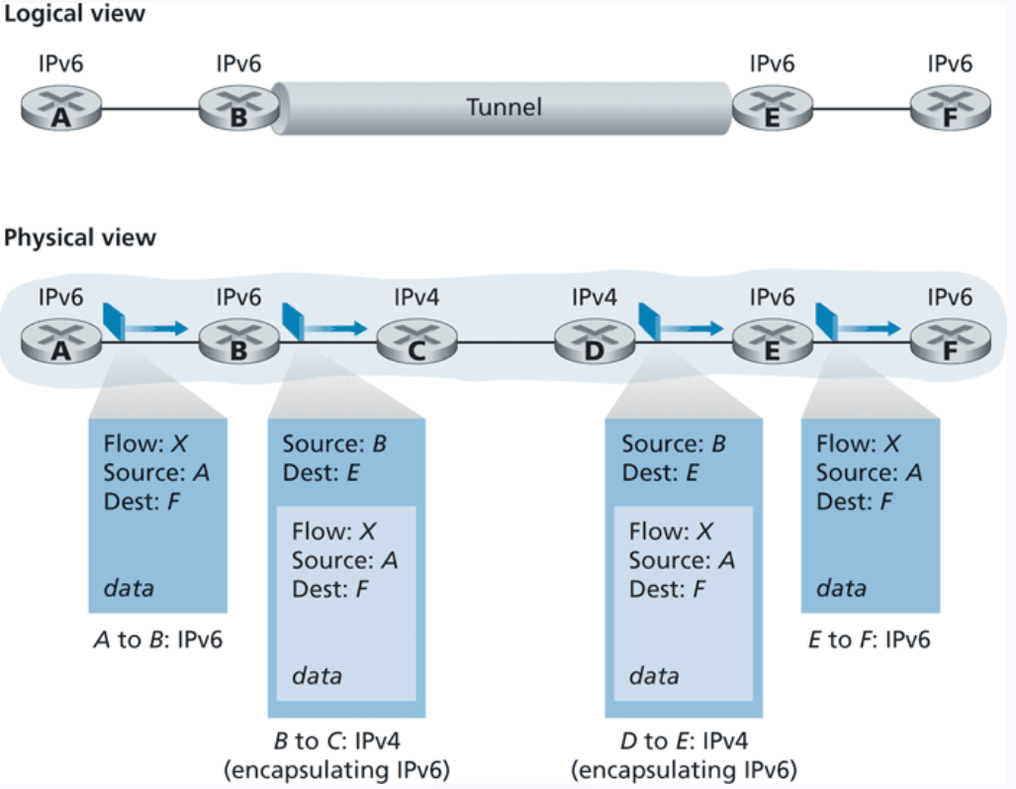
tl:dr
We wrap our IPv6 datagram in an IPv4 header, and pass it to the IPv4 router!

Slide 55
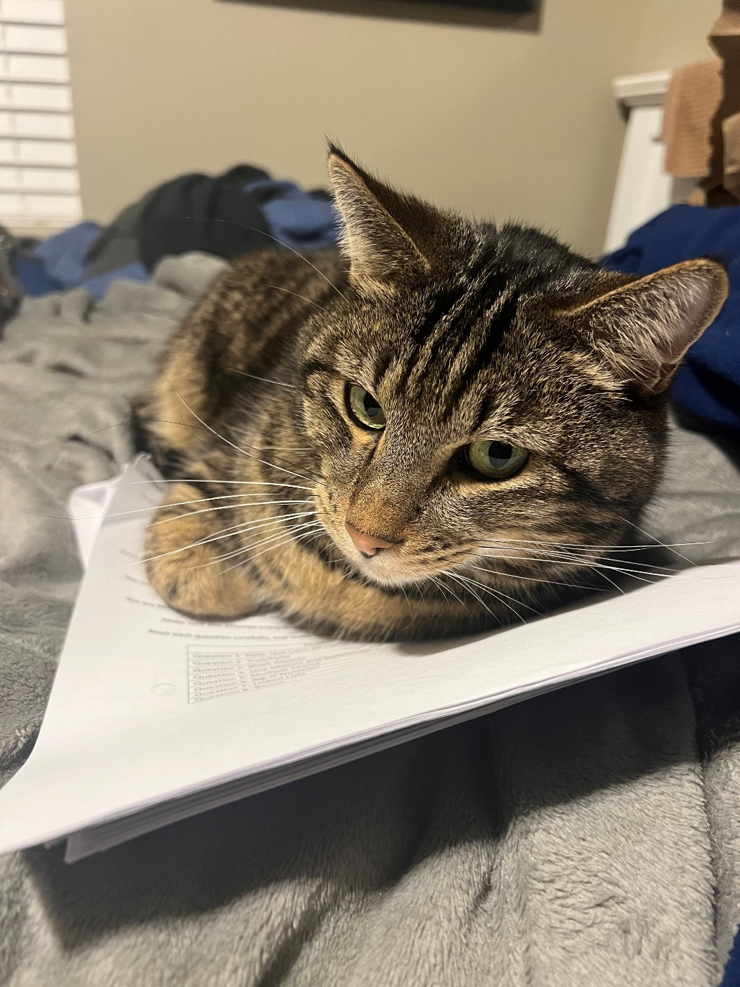

Slide 56
Generalized Forwarding and Software Defined Network (SDN)
So far, a router takes input from input port, and then outputs on some output port
What else might a router need to do?
Forward, Drop stuff, Modify, Load balance
We need more flexibility and functionality with our forwarding!!

Slide 57
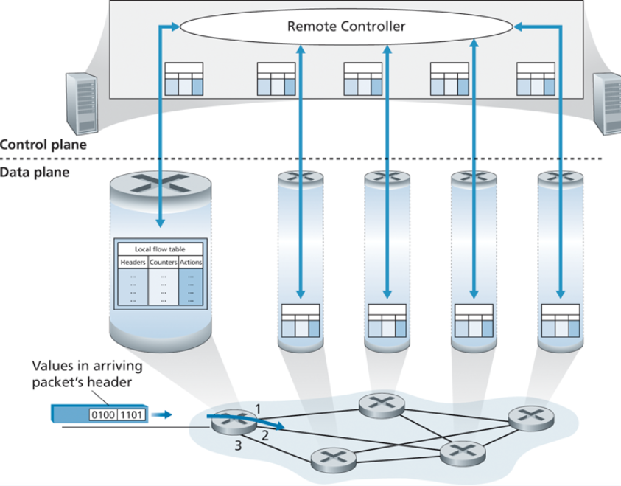
Generalized Forwarding and Software Defined Network (SDN)
Uses OpenFlow standard
A remote controller fills the flow tables of each router
Flow tables are entries of match+action “rules”

Slide 58
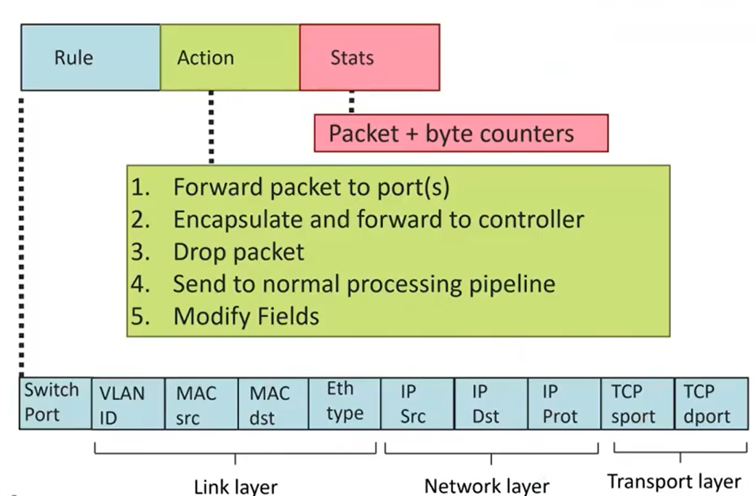
Generalized Forwarding and Software Defined Network (SDN)
Uses OpenFlow standard
A remote controller fills the flow tables of each router
Flow tables are entries of match+action “rules”

Slide 59
Generalized Forwarding and Software Defined Network (SDN)
Uses OpenFlow standard
A remote controller fills the flow tables of each router
Flow tables are entries of match+action “rules”

Slide 60
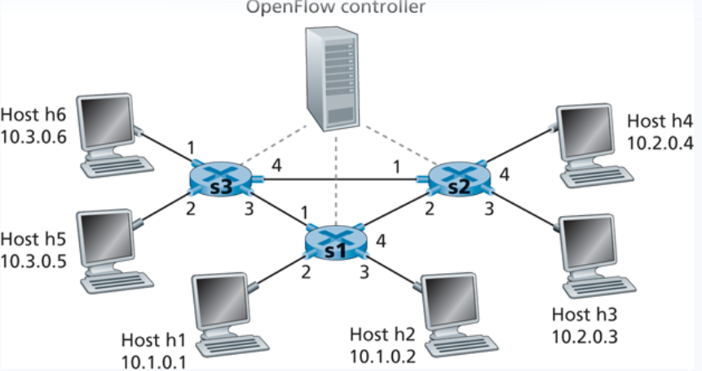
Generalized Forwarding and Software Defined Network (SDN)

Slide 61
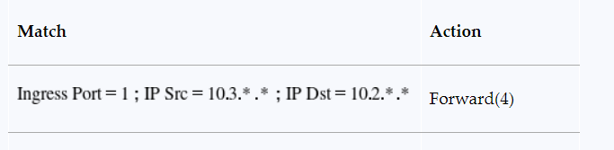




Generalized Forwarding and Software Defined Network (SDN)

Slide 62

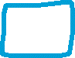



Generalized Forwarding and Software Defined Network (SDN)

Slide 63
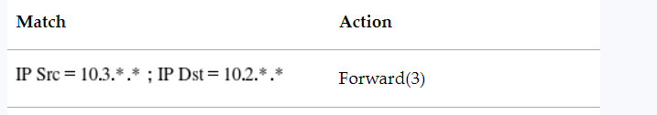

Generalized Forwarding and Software Defined Network (SDN)

Slide 64
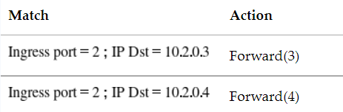


Generalized Forwarding and Software Defined Network (SDN)
Load Balancing

Slide 65
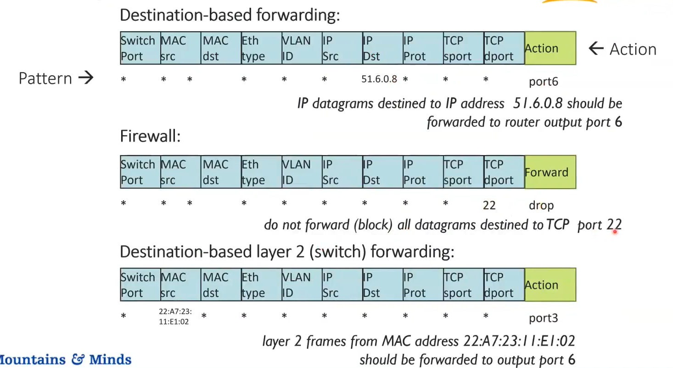
Generalized Forwarding and Software Defined Network (SDN)
22

